Slide 1

FinOps for Snowflake AI
Cortex in Practice
90 Minutes | 9 Modules | Hands-On Labs
DEVOPSDAYS RALEIGH - APR 30 - MAY 1, 2026
Velu Natarajan & Krishnakumar Mohanram
Notes:
#DevOpsDays

Slide 2


About Us
V
Krishnakumar
Velu Natarajan
Data & FinOps Practitioner
Data Clouds Architect
Co-Author and Technical Reviewer of Technical Books
20+ Years of Experience in Data and Cloud Technologies
Contributor to Cloud Center of Excellence, Speaker, and Communities
Oracle ACE Pro
Cloud and data architecture specialist
International conference speaker
Co-Author and Technical reviewer of books
20+ years in enterprise data and cloud technologies
Focused on AI-ready data platforms and multi-cloud interoperability

Slide 3
Workshop - https://tinyurl.com/4fhaeb68

Slide 4
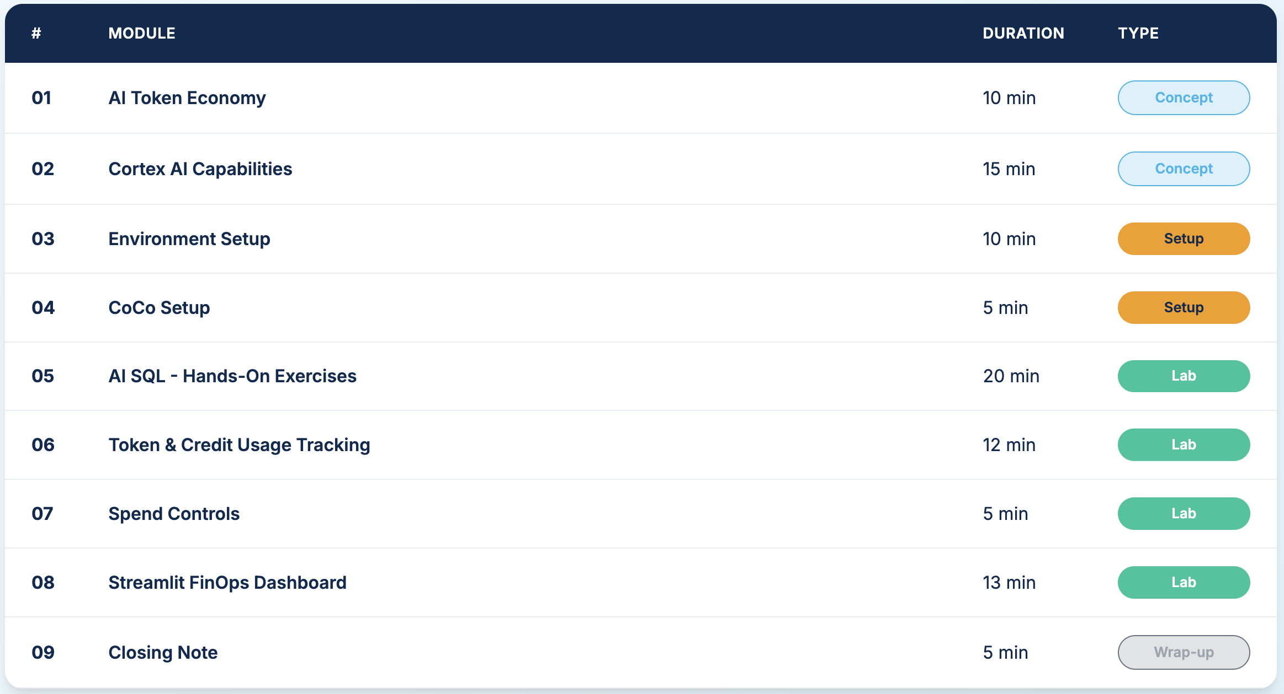
Training Agenda

Slide 5
AI Is Now a Cost Center
Layer 1: Warehouse Compute
▸ Traditional Snowflake billing
▸ Based on warehouse size × time
▸ Stops when warehouse suspends
Layer 2: AI Token Credits
▸ New billing layer for Cortex AI
▸ Based on tokens consumed per call
▸ Does NOT stop on suspend
A misconfigured COMPLETE() loop across 1M rows can exceed a week of warehouse compute in minutes

Slide 6
Token Economics & Shadow Waste
Module 01 - From tokens to dollars, and where savings hide
Token Cost Estimator
▸ Estimate daily/monthly credit burn per model
▸ Formula: rows × avg_tokens ÷ tokens_per_credit
▸ Dollar projection at $3/credit
▸ Same 10K rows: mistral-7b = 0.001 cr vs claude-3-5-sonnet = 0.075 cr
▸ Interactive calculator in Module 01 Section D
Shadow Waste Savings
Task | COMPLETE() | Specialized | Savings
Sentiment | 0.30 cr | 0.02 cr | 93%
Translate | 0.45 cr | 0.05 cr | 89%
Classify | 0.30 cr | 0.03 cr | 90%
Extract | 0.30 cr | 0.04 cr | 87%
Using COMPLETE() for tasks with specialized functions is the #1 source of shadow waste.
Shadow Waste = AI credit consumption that delivers little or no business value.

Slide 7
Cortex AI Capability Map
Module 02 - Four categories of AI in Snowflake
LLM Functions
▸ COMPLETE() - General LLM
▸ SENTIMENT() - Lowest cost
▸ SUMMARIZE() · TRANSLATE()
▸ CLASSIFY_TEXT() · EXTRACT_ANSWER()
Search & Embed
▸ Cortex Search (standing cost)
▸ EMBED_TEXT_768() / 1024()
▸ Cortex Analyst
ML Functions
▸ FORECAST() · ANOMALY_DETECTION()
▸ CLASSIFICATION()
▸ CONTRIBUTION_EXPLORER()
Cortex Code
▸ Natural language → SQL generation
▸ CLI + Snowsight · Agentic workflows
▸ Own SERVICE_TYPEs for cost tracking
Strategy: Start with specialized functions before reaching for COMPLETE(). They are optimized and cheaper

Slide 8
Model Cost Tiers
Same task, different models = 10-50x cost difference
Budget
▸ mistral-7b - 8.3M tok/cr
▸ llama3-8b - 5.3M tok/cr
▸ gemma-7b - 8.3M tok/cr
Standard
▸ llama3-70b - 826K tok/cr
▸ mixtral-8x7b - 4.5M tok/cr
▸ snowflake-arctic - 1.2M tok/cr
Premium
▸ claude-3-5-sonnet - 667K/133K
▸ llama3.1-405b - 333K tok/cr
▸ mistral-large - 196K tok/cr
Extraction, classification, high volume
Complex reasoning, nuanced analysis
Highest quality, coding, long-form
The right model is the cheapest one that meets your quality bar

Slide 9
Environment Setup
Modules 03-04 - Cortex Code CLI + Governed Lab Environment
Cortex Code CLI (Module 03)
▸ Install via curl or PowerShell
▸ Connect to Snowflake account
▸ First prompt: natural language → SQL
▸ Commands: /status, /help
Lab Environment (Module 04)
▸ Database: cortex_lab · Schema: ai_workshop
▸ Warehouse: cortex_wh (SMALL, 60s suspend)
▸ Resource Monitor: 50 credits, 90% suspend
▸ Role: cortex_analyst
▸ Sample: TPCH data
The Resource Monitor guards warehouse compute credits, not AI token credits.
AI credits are billed separately.
Use Budgets and METERING_DAILY_HISTORY to track AI spend.

Slide 10
AI SQL Hands-On Exercises
Module 05 - Run Cortex functions and compare costs
Ex 1: SENTIMENT()
▸ Analyze customer feedback sentiment
▸ No model param needed
Ex 2: CLASSIFY_TEXT()
▸ Route feedback to support teams
▸ Zero-shot classification
Ex 3: COMPLETE()
▸ Extract structured info from text
▸ Using budget model mistral-7b
Ex 4: Model Cost Comparison
▸ Same prompt, 3 models:
▸ mistral-7b vs llama3-70b vs claude-3-5-sonnet
Ex 5: Scale Simulation
▸ Test on 5 rows → measure cost → project to 500K rows → decide

Slide 11
Token & Credit Usage Tracking
Module 06 - Your real-time FinOps console
Q1–Q5: Core Tracking
▸ AI credits by function, model, hour
▸ Cost projection from dedicated views
Q6: Idle Search Detection
▸ Search indexing with zero queries
▸ 100% waste (Transition → Module 07)
Q7: Over-Sized Models
▸ credits_per_1M_tokens metric
▸ Find where cheaper models suffice (40–75% savings)
Q8–Q9: Redundant Calls & Prompt Bloat
▸ Duplicate pipelines detected
▸ Rising avg tokens/call over time
Q10–Q11: Agent Loops & Dev in Prod
▸ MAX vs AVG credit gap
▸ LATERAL FLATTEN(ROLE_NAMES)
Q12–Q13: Anomaly & Attribution
▸ WoW LAG(7) spike detection
▸ Tagged vs untagged spend ratio
Shadow Waste: Detect patterns of hidden AI credit drain.
AI services are serverless - no warehouse to watch, no query fails. Credits silently accumulate.
#DevOpsDays

Slide 12
AI Credits Transition
Module 07 - New SERVICE_TYPE billing you need to track
4 New SERVICE_TYPEs
Detection Query
SERVICE_TYPE | Description
CORTEX_AGENTS | Agentic AI workflows
CORTEX_CODE_CLI | Cortex Code CLI usage
CORTEX_CODE_SNOWSIGHT | Cortex Code in browser
SNOWFLAKE_INTELLIGENCE | Snowflake Intelligence
SELECT SERVICE_TYPE,
SUM(CREDITS_USED) AS credits,
credits * 3 AS est_cost
FROM SNOWFLAKE.ACCOUNT_USAGE
.METERING_DAILY_HISTORY
WHERE SERVICE_TYPE LIKE 'CORTEX%'
OR SERVICE_TYPE = 'SNOWFLAKE_INTELLIGENCE'
GROUP BY 1 ORDER BY 2 DESC;
These credits appear in METERING_DAILY_HISTORY but NOT in CORTEX_AI_FUNCTIONS_USAGE_HISTORY.
You must check both views for complete AI cost visibility.

Slide 13
Streamlit FinOps Dashboard
Module 08 - Build with Cortex Code, deploy to Snowflake
KPI + Visualizations
▸ Total Queries, Credits, Avg/Call, Users, Est. $
▸ Hourly Trend · Function Breakdown
▸ Model Cost Comparison · Top Expensive Queries
Attribution Coverage
▸ Tagged vs Untagged donut chart
▸ % coverage metric (target: >90%)
WoW Anomaly Detection
▸ Daily spend vs same day last week
▸ Color-coded: >50% yellow, >200% red
Sample Dashboard Output
▸ CSS mockup preview in Module 08 Section C
▸ 5 KPI cards · Donut · Area chart · Cost grid
Deploy: Snowsight → Projects → Streamlit → + Streamlit App → Paste code → Run

Slide 14
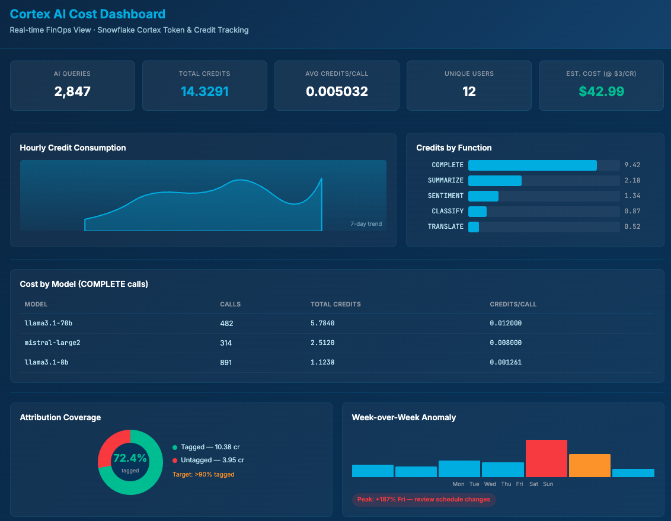

Slide 15
Quick Reference: 5 ACCOUNT_USAGE Views
Module 09 - The views you need for complete AI cost visibility
View | Tracks | Key Columns
CORTEX_AI_FUNCTIONS_USAGE_HISTORY | LLM / task functions | FUNCTION_NAME, MODEL_NAME, CREDITS, USER_ID
CORTEX_AISQL_USAGE_HISTORY | AI SQL tokens | TOKENS, TOKEN_CREDITS, QUERY_TAG, USER_ID
DOCUMENT_AI_USAGE_HISTORY | Document AI | CREDITS_USED, PAGE_COUNT
CORTEX_SEARCH_DAILY_USAGE_HISTORY | Search services | SERVICE_NAME, CREDITS
METERING_DAILY_HISTORY | All SERVICE_TYPEs | SERVICE_TYPE, CREDITS_BILLED
USER_ID in Cortex views is a NUMBER. JOIN to SNOWFLAKE.ACCOUNT_USAGE.USERS for names. ~45 min latency on all views.

Slide 16
The Three FinOps Habits for AI
ESTIMATE
Test on 10 rows. Project to full dataset. Decide.
MONITOR
Dashboard is your early warning system. Check weekly.
CHOOSE
The cheapest model that meets your quality bar.
AI Governance Principles
Credit Burn
AI costs scale with data volume, not warehouse size
Behavior
Model choice & prompt design drive cost, not infra
Visibility
Dedicated views, not query_history, for AI tracking
Signals
Shadow waste hides where traditional monitors can’t see

Slide 17
What You Built Today
01-02
Token Economy & Cortex AI
03-04
Environment & Setup
05
AI SQL Hands-On
06
Cost Tracking
07
AI Credits Transition
08
FinOps Dashboard
09
Govern & Scale
AI spend will grow. The teams who govern it now will be the ones who can afford to scale it later.
AI spend will grow. The teams who govern it now will be the ones who can afford to scale it later.

